Slide 1
Music Genre Prediction Natural Language Processing – 665339 Final Project Presentation
Submitted To:
Nava Shaked, PhD

Slide 2
Introduction
What will this project examine?
Is there a connection between a song’s textual structure and corpus to its genre?
Is there a connection between a song’s textual structure and corpus to its era?
Is there a connection between a song’s textual structure and corpus to its popularity?

Slide 3
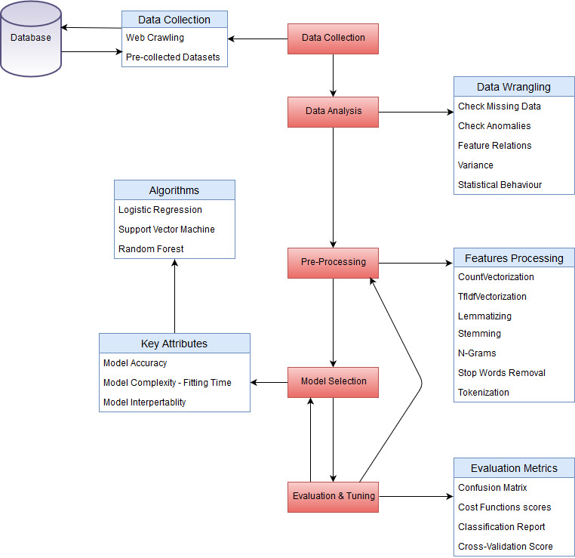
System Design

Slide 4
Data Collection – The Data
The data was retrieved by various sources from: www.kaggle.com
Metadata:
Table 1: Artists
Artist – STRING – The name of the specific artist
Songs – INT(Continuous Numerical) – The amount of songs the artist released
Popularity – FLOAT(Continuous Numerical) – The artist’s popularity
Link – STRING – The artist’s domain page
Genre – STRING – The artist’s main play style genre
Genres – STRING – The artist’s sub-genres playing style

Slide 5
Table 2: Lyrics
Alink – STRING – The artist’s domain page
Sname – STRING – The artist’s/band’s song name
Slink – STRING – HTML Link to the artist’s song page
Lyric – STRING – The lyrics for the specific song
Idion – STRING – The language of the specific song
Table 3: Lyrics2
Song – STRING – The song’s name
Year - INT(Continuous Numerical) - The year the song was released
Artist – STRING – The name of the artist/band
Genre – STRING - The artist’s main play style genre
Lyrics – STRING – The lyrics of the specific song

Slide 6
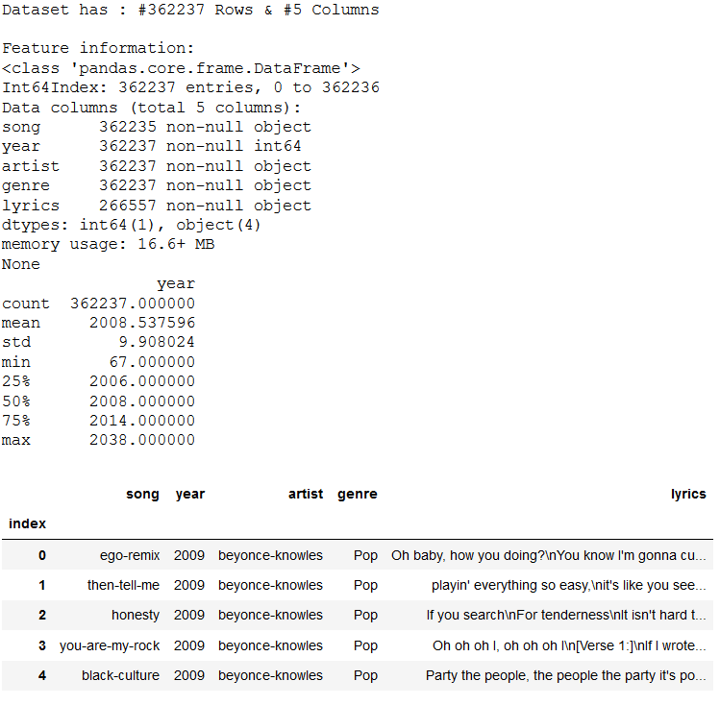
Table 1

Slide 7
Can You Spot the Anomaly?

Slide 8
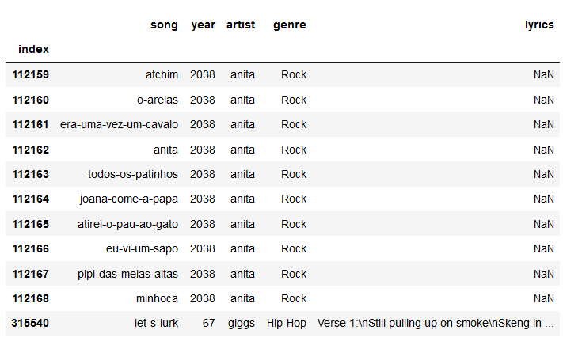
There appears to be some records from artists in the future!
Also, we can see that Hip Hop already existed back in the year 67!

Slide 9
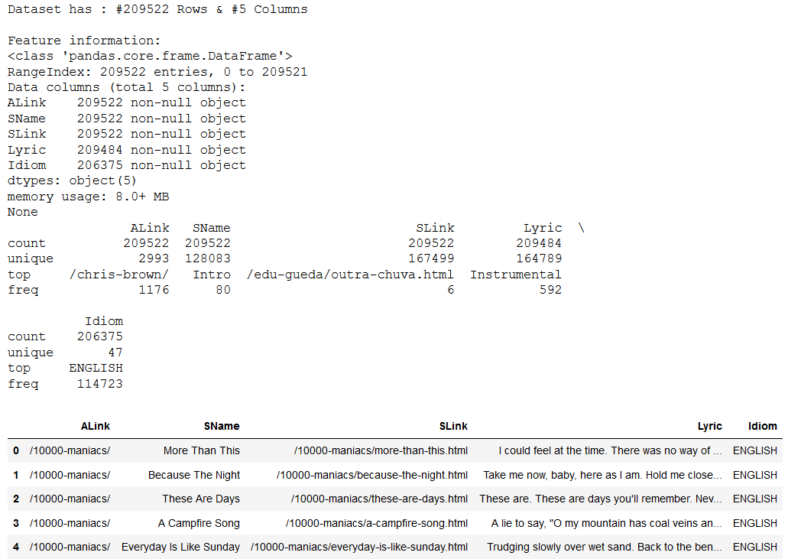
Table 2

Slide 10
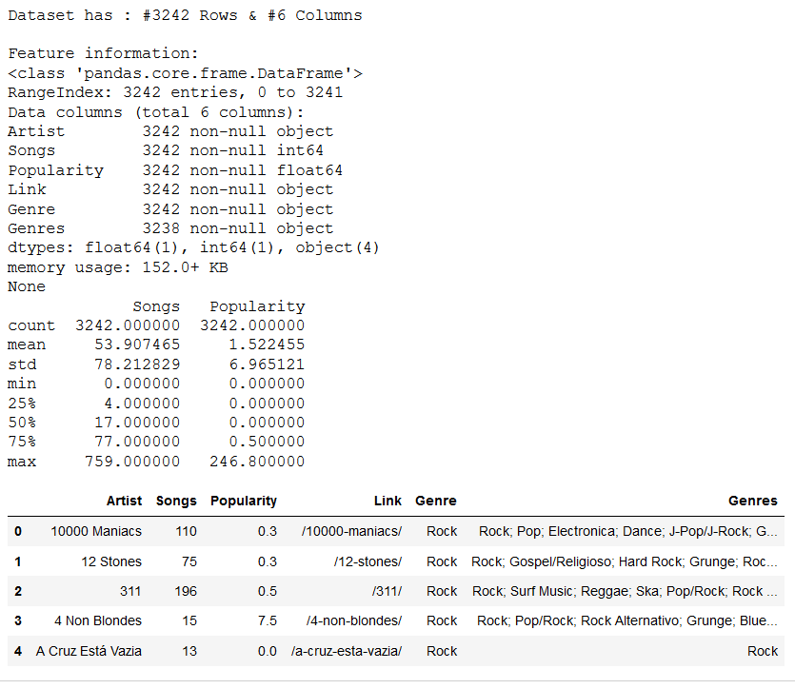
Table 3

Slide 11
How About Now? Can You Spot the Anomaly?

Slide 12
It Seems like the noisy sample is Ariana Grande!
But is it truly a noisy sample?

Slide 13
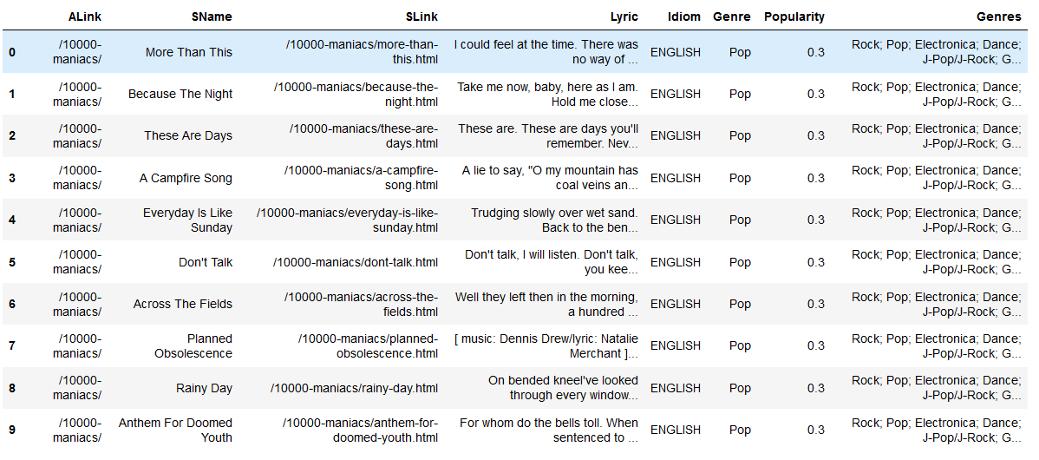
Final Data set

Slide 14
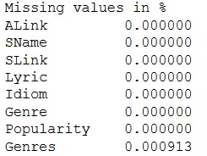
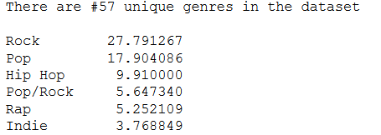
Data Exploration & Pre-Processing
Sometimes data contains missing values
Sometimes there are just not enough samples from each class (low variance)

Slide 15
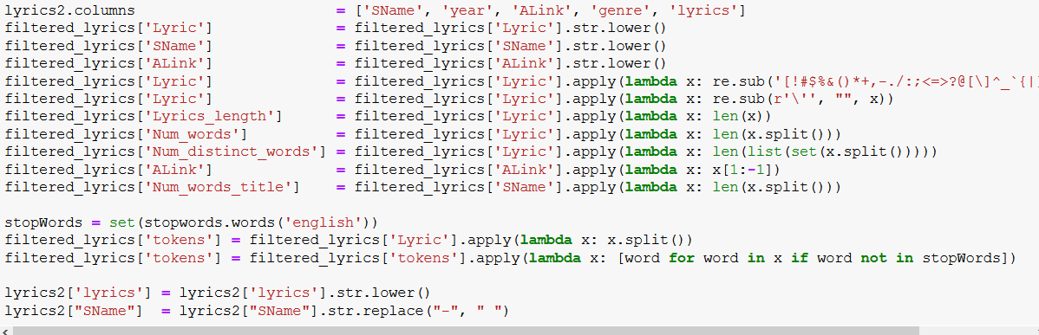

Slide 16
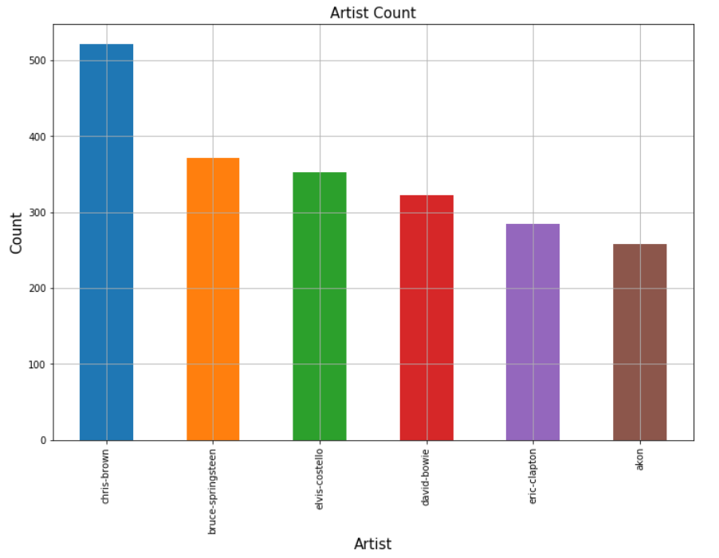
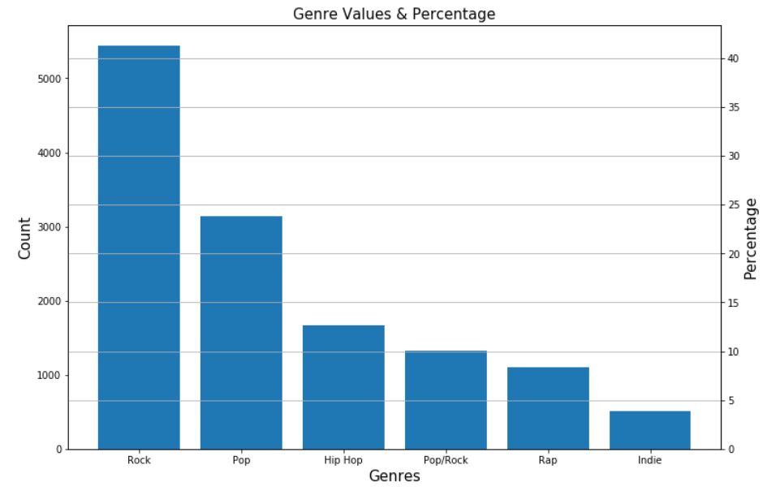

Slide 17

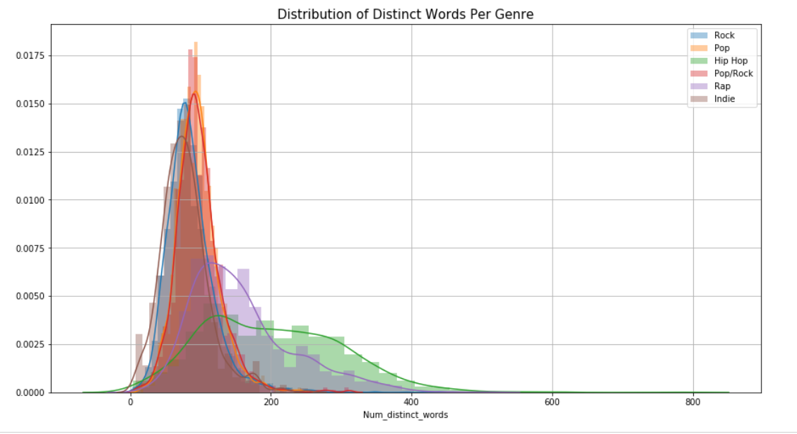
We can see that some genres appear to have a Normal Distribution of the number of distinct words, i.e.:
While some genres appear to have a mixture of distributions, these include the “Rap” & “Hip Hop” Genres

Slide 18
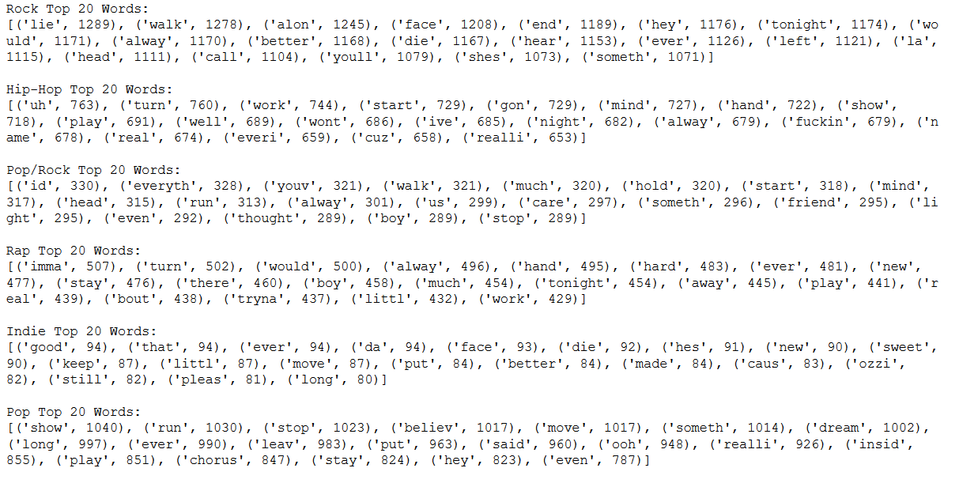
Most Common Words Per Genre

Slide 19
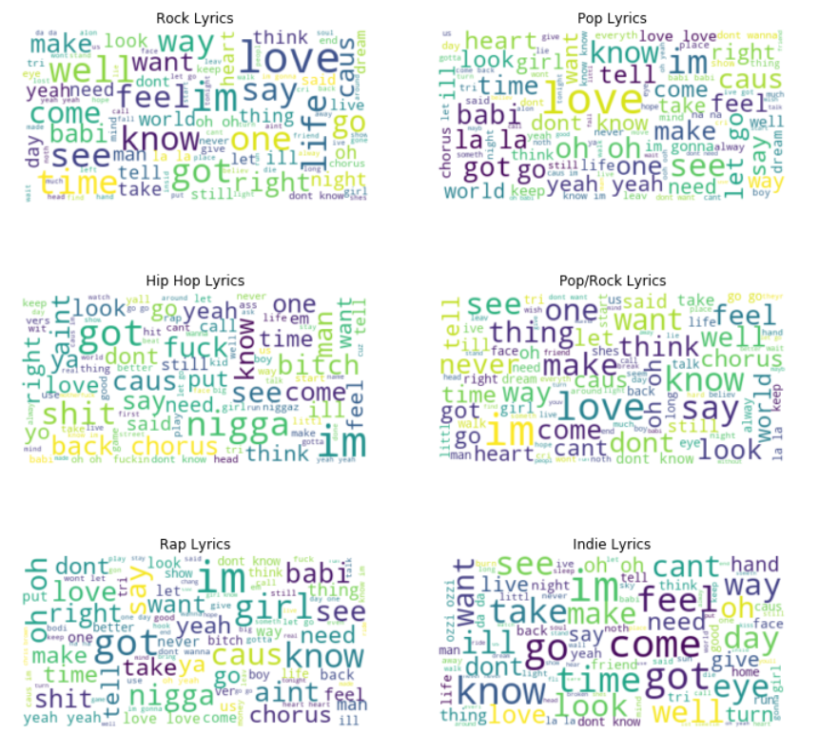

Slide 20
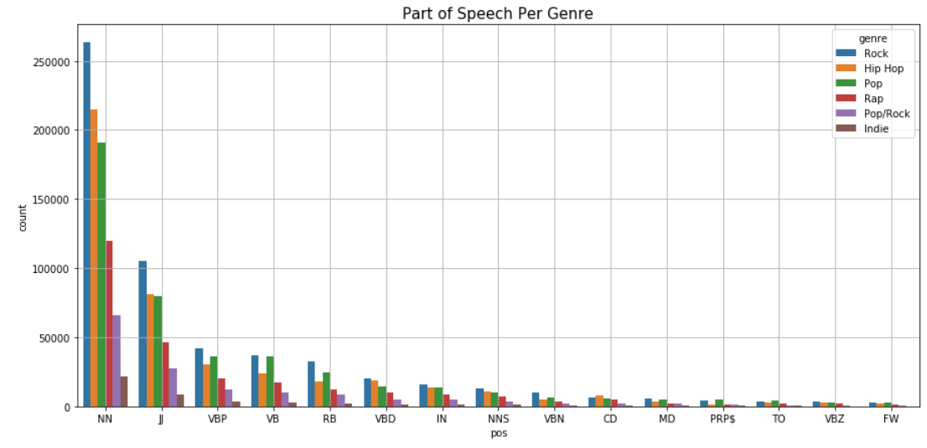
We can see that Rock leads in almost every part of speech category, this is a bit biased since rock comprises most of our data

Slide 21


By inspecting the CDF for each genre’s feature, we can examine the differences between genres in a more thorough way – even contradicting common beliefs
To calculate the CDF (Cumulative Distribution Function), we first need to calculate the PDF (Probability Density Function)

Slide 22
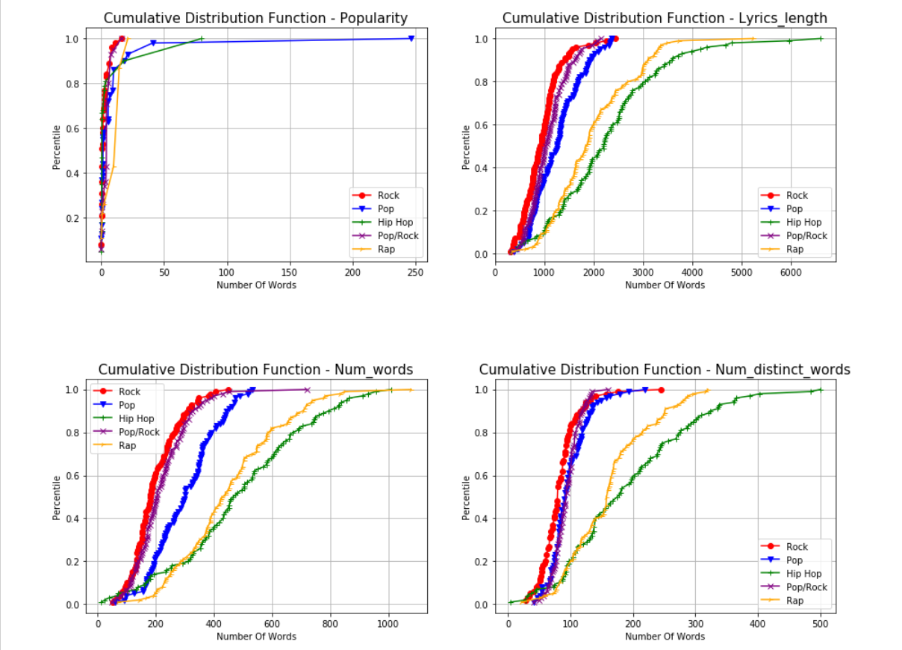

Slide 23
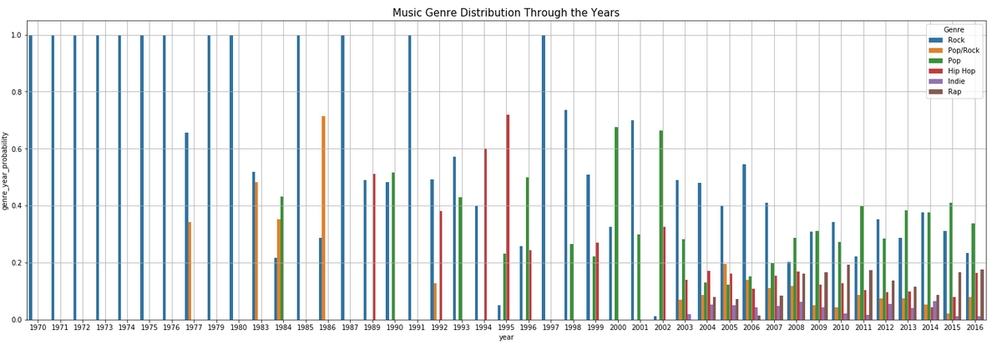
We can see that as time progressed, more genres appeared.
We can observe the change in trends – noticing that as time went by “Rock” was dethroned by the “Pop” genre

Slide 24
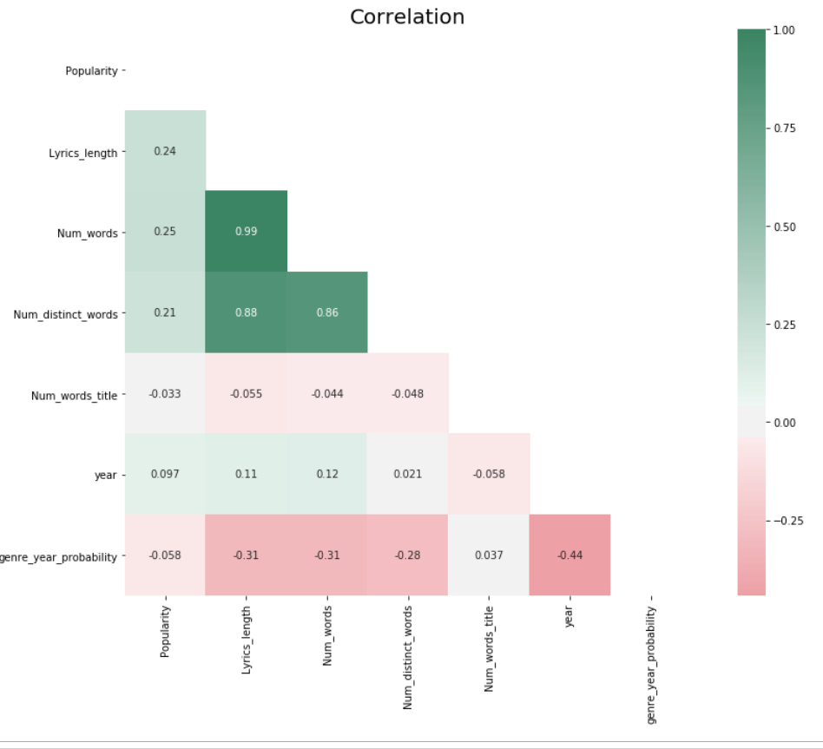

Slide 25
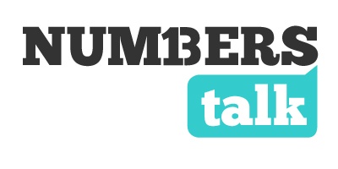
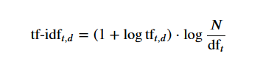

Data Transformation
Algorithms understand numbers! not words
Text Transformation – Tf-IDF
Where:

Slide 26
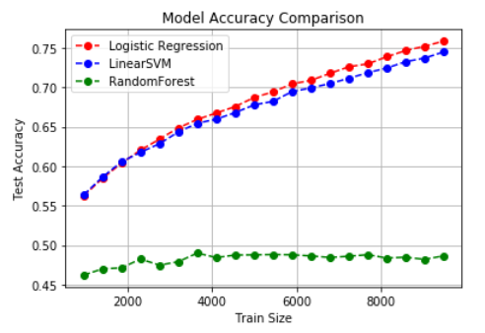
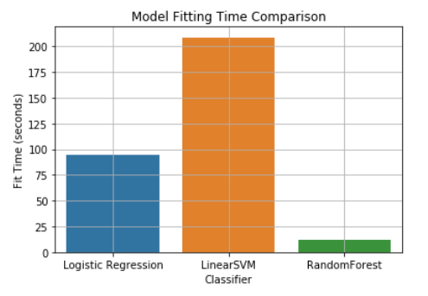
Model Selection
How do we choose our model?
Approaches:
Pray to god
Copy someone else’s work
Educated guess
Test for yourself and compare the results

Slide 27









Some Math!
Seems like the Logistic Regression model worked best
How does it work?
Gradient Descent
It is the derivative of the cost function
Where:
So we can formulate this like this
Where & is the sigmoid function
So Finally, we can formulate this as:
And develop the formula to support a larger dimension problem

Slide 28
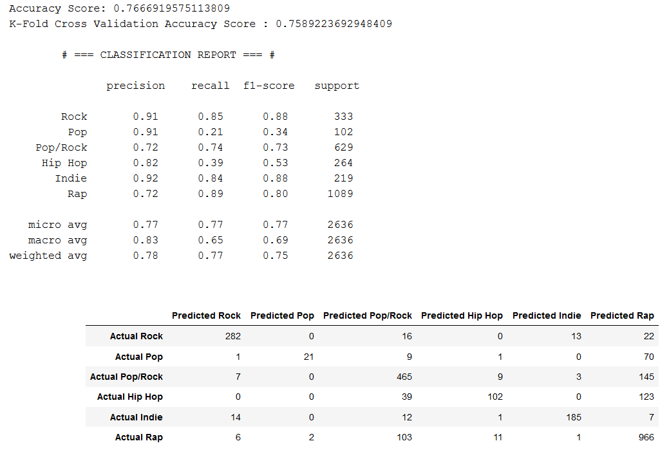
Results

Slide 29
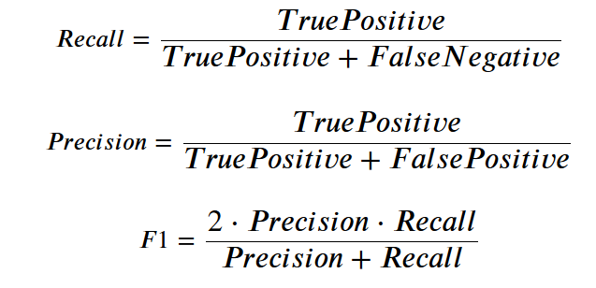
Numbers Sometimes Lie

Slide 30
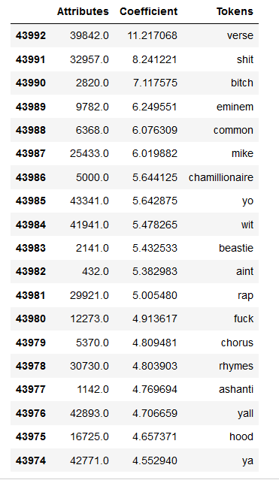
Most Meaningful Keywords

Slide 31
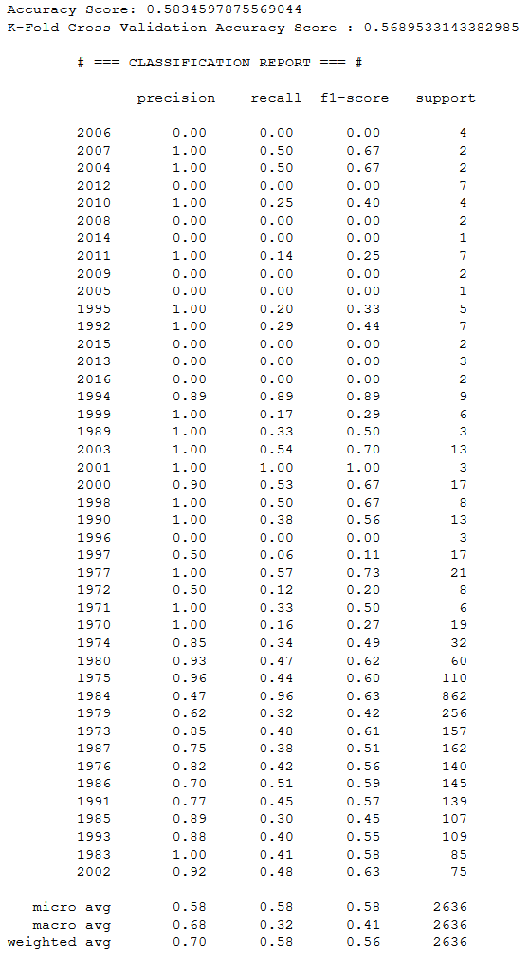
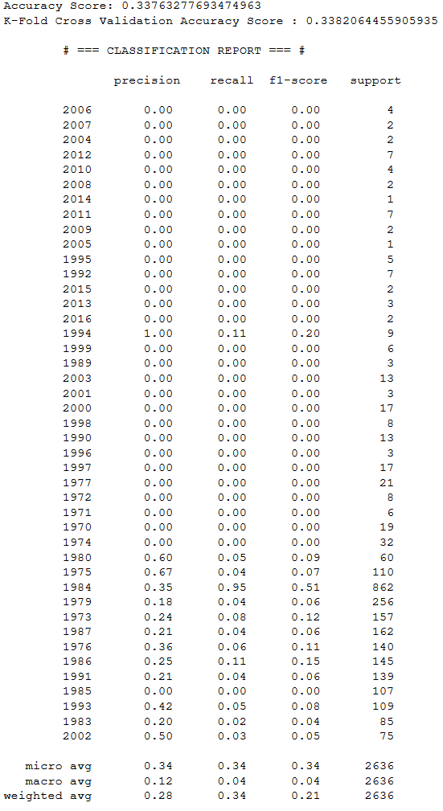
Year Prediction Word Level N-Gram Character Level N-Gram

Slide 32
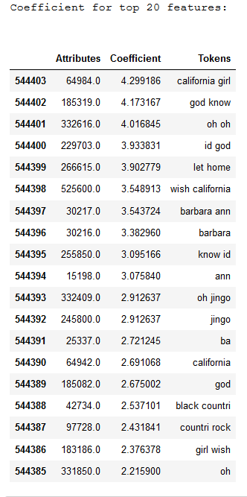

Slide 33
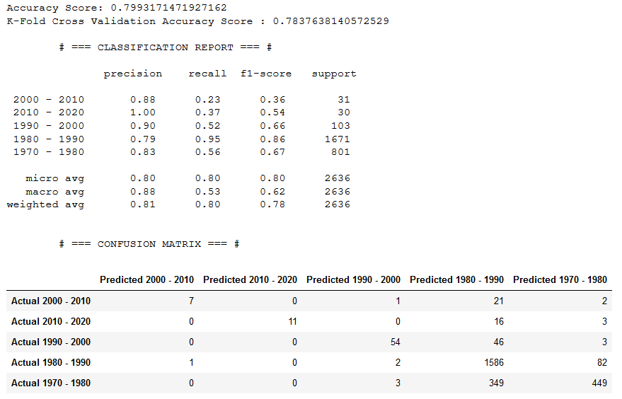
Year Prediction - Era

Slide 34

Popularity Prediction
Popularity is a continuous numerical target – Therefore we cannot use a classification method, but Regression instead
LINEAR REGRESSION TO THE RESCUE!
Different Approach – Different Scoring – RMSE (Root Mean Squared Error)
We achieved a K-Fold Cross Validation Score of: 284.4
It seems like our model fails, but why?
Noise(Remember Ariana Grande)
Amount of data (Curse of dimensionality)
Lackluster algorithm

Slide 35
Conclusions
Some genres are highly correlated to their lyrical structure and corpus
Some genres lyrical structure and corpus resemble or have a high similarity to other genres, i.e. “Hip Hop” and “Rap”
Achieving a 77% accuracy with 6 different classes(genres) is not something to turn a blind eye to
Seems like there’s a slight connection between the lyrical structure and a song’s corpus to its era & specific year of release
There appears to have no sort of ability to predict whether a song will be popular based on its lyrics

Slide 36
Future Work
Obtain more data – Optimal balanced dataset
More feature extraction/selection
Further hyper parameter tuning
Deep Learning Architectures

Slide 37
Questions?

